Slide 1
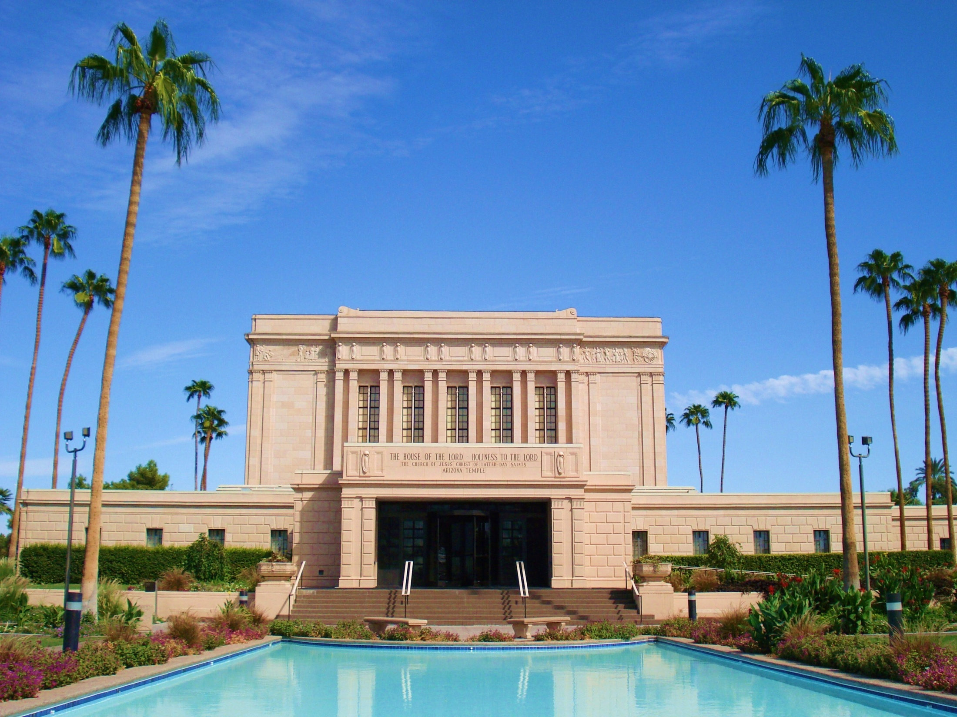
THE POWERFUL TOOL OF THE SPIRIT

Slide 4
THE SACRED GIFT OF THE HOLY GHOST
POWER TO PROTECT US
POWER TO TEACH US
POWER TO DIRECT US

Slide 5
66 ¶From that time many of his disciples went back, and walked no more with him.

Slide 6
JOHN 20
2 Then she runneth, and cometh to Simon Peter, and to the other disciple, whom Jesus loved, and saith unto them, They have taken away the Lord out of the sepulchre, and we know not where they have laid him.

Slide 7
EVEN APOSTLES NOT SURE
3 Peter therefore went forth, and that other disciple, and came to the sepulchre.
4 So they ran both together: and the other disciple did outrun Peter, and came first to the sepulchre.
10 Then the disciples went away again unto their own home.

Slide 8
JOHN 7:39
39 (But this spake he of the Spirit, which they that believe on him should receive: for the Holy Ghost was not yet given; because that Jesus was not yet glorified.)

Slide 9
JOHN 16:7
7 Nevertheless I tell you the truth; It is expedient for you that I go away: for if I go not away, the Comforter will not come unto you; but if I depart, I will send him unto you.

Slide 10
JOHN 14:26
26 But the Comforter, which is the Holy Ghost, whom the Father will send in my name, he shall teach you all things, and bring all things to your remembrance, whatsoever I have said unto you.

Slide 11
JOHN 20:22
22 And when he had said this, he breathed on them, and saith unto them, Receive ye the Holy Ghost:

Slide 12
3 NEPHI 19:9
9 And they did pray for that which they most desired; and they desired that the Holy Ghost should be given unto them.

Slide 13
3 NEPHI 19:20-21
20 Father, I thank thee that thou hast given the Holy Ghost unto these whom I have chosen; and it is because of their belief in me that I have chosen them out of the world.
21 Father, I pray thee that thou wilt give the Holy Ghost unto all them that shall believe in their words.

Slide 14
THE POWERFUL TOOL OF THE SPIRIT

Slide 15
HOLY GHOST OR GIFT OF THE HOLY GHOST
HOLY GHOST
TEMPORARY IMPRESSIONS AND FEELINGS
CANNOT BE WITH US ALWAYS
DEPENDENT UPON EXTERNAL EVENTS
ALL PEOPLE HAVE THE RIGHT TO HOLY GHOST INFLUENCE

Slide 16
THE GIFT OF THE HOLY GHOST MUST BE BAPTIZED AND CONFIRMED MUST RECEIVE/INVITE TO RECEIVE/INVITE MUST BE WORTHY AND OBEY MUST LISTEN AND ACT INVITE DAILY

Slide 17
LEARN FROM THE SPIRIT
The spirit cannot abide that which is vulgar, crude, sinful or immodest.
Elder David A. Bednar

Slide 18
WHICH WAY DO WE GO PATTERN ONE
1. PRAYED IN MORNING
2. MISSED SEMINARY
3. READ SCRIPTURES
4. UP LATE DID NOT PRAY
5. LISTENED TO BAD MUSIC
6. WENT TO BAD PARTY
7. BROKE WORD OF WISDOM
8. DON’T READ SCRIPTURES OR PRAY VERY OFTEN
9. INVOLVED IN IMMORALITY
10. DON’T ATTEND CHURCH VERY OFTEN

Slide 19
WHICH WAY DO WE GO PATTERN TWO
1. TRYING TO DO GOOD
2. ATTENDED CHURCH
3. READ SCRIPTURES
4. PRAYED MORNING AND NIGHT
5. LISTENED TO BAD MUSIC
6. READ SCRIPTURES 7 DAYS IN A ROW
7. ATTENDED ALL THREE HOURS OF CHURCH
8. DID NOT PLAY ON PHONE, BUT LISTENED IN CHURCH
9. PRAY EVERYDAY
10. ATTEND CHURCH EVERY WEEK
11. INVITED FRIEND TO CHURCH ACTIVITY AND THEY CAME
12. INVITED FRIEND TO CHURCH ACTIVITY, BUT WOULDN’T COME
13. INVITED ANOTHER FRIEND TO LISTEN TO LESSONS

Slide 20
WHICH WAY DO WE GO
14. READING SCRIPTURES EVERYDAY
15. HELP FAMILY AND FRIENDS
16. ATTEND CHURH AND ARE PREPARED
17. PRAY WITH MORE DILIGENCE
18. SEARCH THE SCRIPTURES
JOSEPH SMITH: NEARER WE ATTAIN PERFECTION OUR VIEWS WILL BE CLEARER, GREATER UNDERSTANDING AND LOSE DESIRE FOR SIN.

Slide 21
P A S S
PRAY
ATTEND
STUDY
SERVE

Slide 22
